Slide 1


OPEC as a Destabilizing Influence
Marc H. Vatter
Economist
Elevation Direct Corporation
elevationdirect.com

Slide 2
The OPEC Era
During the fifties and sixties, the world oil market was cartelized by a group of large firms known as the “Seven Sisters”, working in concert with the Texas Railroad Commission (TRR). According to Sampson (1975), the Sisters had to collude tacitly and hide it from the U.S. Antitrust Division. This led to stable prices.
On March 16, 1972, the TRR ended “prorationing” of private producers.
On October 6, 1973, Egypt and Syria attacked Isreal, which retaliated. OPEC responded with a 5% cut in production on October 17, and the OPEC Era of oil pricing was under way.
During the OPEC Era, prices have been markedly more volatile than in the time of the Sisters and the TRR.

Slide 3
Why the volatility?
Unlike the Sisters, OPEC does not have to collude tacitly.
Short run net demand to OPEC is very inelastic, while long run net demand is much more elastic. Pindyck (1978) found that this difference implied a U-shaped optimal time-path for price for OPEC, with a “price shock” at the outset.
Oil prices affect the world economy, an externality other cartels need not take into account.
  Increases in oil prices lower world GDP more than decreases in oil prices raise it. Mork (1994) attributed this to downwardly sticky wages. If everyone uses oil products to travel to work, then oil is a complement to labor in the production of everything, and an increase in the price of oil will cause unemployment if wages are sticky in the downward direction.
  The asymmetry means that there are multiple equilibrium prices for the cartel. (It also implies that volatility lowers world GDP over time.)
  Volatility in price gives OPEC a countercyclic stream of revenue, which, when securitized, can command a risk premium in financial markets.

Slide 4
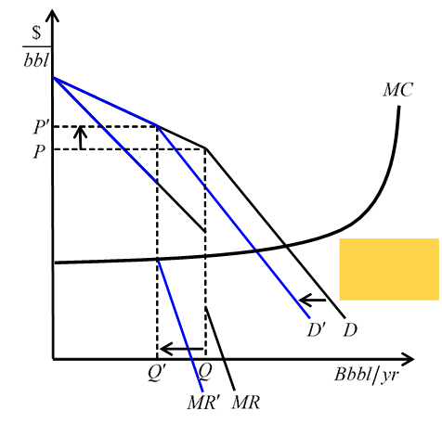
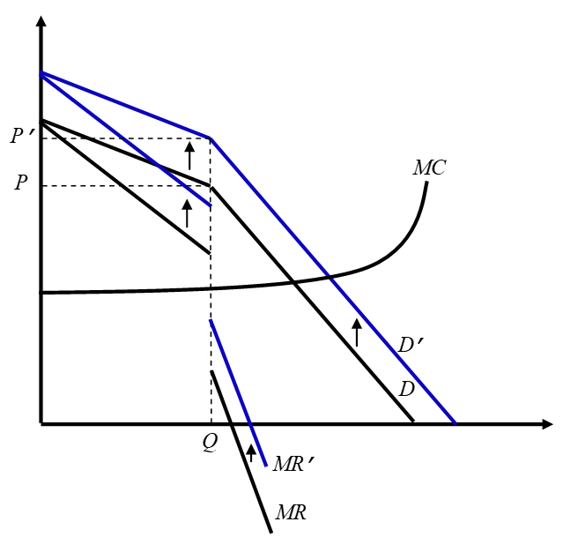
Asymmetry and multiple equilibria
The asymmetric relationship of GDP to the price of oil means that OPEC’s marginal revenue for an increase in price exceeds its marginal revenue for a decrease in price. Marginal cost runs through the gap over a range of prices, all of which are equilibria.
If OPEC raises price, it has no incentive to return to the previous price.
If net demand to OPEC increases, OPEC has no incentive to increase production.

Slide 5
Quantifying the range
In 2019 QIV, the price of Brent averaged $63.41/bbl.
Updating the model from Vatter (2017), the corresponding long run marginal revenue gap ranged from $14.81 for a decrease in price to $26.76 for an increase in price.
If OPEC’s long run marginal cost was $20.00/bbl, long run equilibrium prices ranged from $50.62 to $74.41.
Within-quarter, if OPEC cared nothing about subsequent “demand destruction”, at a lifting cost of $3.00/bbl, equilibrium prices would have ranged from $1,073 to $1,108.
Of course, OPEC does care about subsequent demand destruction, but the higher OPEC’s discount rate, the greater its optimal temporary price shock.

Slide 6
Countercyclic revenue
An asset that pays high returns when the market is down sells for a high price.
Increases in oil prices lower world GDP, so OPEC’s stream of revenues has greater value in financial markets when oil prices are volatile.

Slide 7
OPEC’s revenues and the macroeconomy
In monthly data covering January 1974 to June 2017, personal consumption expenditures in the U.S. correlate positively with OPEC’s revenues, so it would appear that OPEC has nothing to gain here from volatility.
I have shown, though, in Vatter (2019), that personal consumption in the U.S. is very negatively related to changes in OPEC’s revenues that are driven by exogenous changes in the price of oil.
I also showed that, though positively related, OPEC’s revenues are extremely insensitive to exogenous changes in U.S., Chinese, and European personal consumption spending, so they can also be used to hedge systematic risk, even if OPEC lets price increase some with macroeconomic activity.

Slide 8
Saudi Arabia: The swing producer
During the 44 largest month-to-month percentage drops in non-Saudi OPEC production since 1973, Saudi Arabia increased production 12 times, left production unchanged 10 times, and decreased production 22 times; during 11 of these, the percentage drop in Saudi production exceeded that in non-Saudi production.
Saudi Arabia does not generally use its position of leadership in the cartel to stabilize the market.

Slide 9
Examples
“…in 1978–80, the oil price tripled for the usual reason: not that wells were giving out but because OPEC nations, particularly Saudi Arabia, shut in production rather than let it expand to make up for Iranian fluctuations.” - Morris Adelman (2004)
When Libyan production plummeted in February and March of 2011 as the Gadhafi government fell, the Saudis decreased their own. According to a Reuters article dated April 18, 2011,
  Saudi Arabia's oil minister said on Sunday the kingdom had slashed output by 800,000 barrels per day in March due to oversupply, sending the strongest signal yet that OPEC will not act to quell soaring prices. Consumers have urged the exporters' group to pump more crude to put a cap on oil, which surged to more than $127 a barrel this month, its highest level in 2 1/2 years amid unrest in North Africa and the Middle East. Oil Ministers from Kuwait and the United Arab Emirates echoed Saudi Arabia's Ali al-Naimi's concerns about oversupply and said rocketing crude prices were out of the hands of OPEC, which next meets in June.

Slide 10
Impact of the shale boom
Tight oil supply is much more price-elastic than convential non-OPEC production.
This decreases OPEC’s market power and incentive toward volatility, but by how much, and for how long?
Golombek et al. (2018) noted: “There are not many estimates of the non-OPEC supply elasticity in the literature.” They estimated the long run price elasticity of non-OPEC supply to be 0.32, and they cite Alhajji and Huettner (2000), who estimated it to be 0.29. Vatter (2017) estimated it to be 0.24. Pierru et al (2020) assume it to be 0.3.

Slide 11
Impact of the shale boom
In Vatter, Van Vactor, and Coburn (2020), we estimate the long run price elasticity of tight oil supply in the Bakken Shale to exceed 1.9.
In Vatter (2018), I estimate that the shale boom increases the absolute elasticity of net demand to OPEC, for an increase in price, by about 0.5 through 2030.

Slide 12
Disagreement
In its mission statement, OPEC claims to “ensure the stabilization of oil markets”.
Pierru et al conclude that “…OPEC has succeeded to a limited but important degree in its attempt to employ spare capacity to offset shocks and stabilize the price of oil.”
They assume long run price elasticities of demand and non-OPEC supply of -0.3 and 0.3, respectively, and a hypothetical stable price of $56.43/bbl in 2018$. In my model, these values imply a price elasticity of net demand to OPEC of -1.12.
Using the estimates of demand and non-OPEC supply from Vatter (2017), and $56.43/bbl in 2018 QIII, gives elasticities of net demand to OPEC of -1.58 for an increase in price and -1.19 for a decrease. Pierru et al’s less elastic net demand, especially for increases in price, result in lower estimates of the “call on OPEC” production needed to stabilize price, and, therefore, in a picture of OPEC as a more stabilizing, or less destabilizing, influence.

Slide 13
References
Adelman, M.A. (2004). “The real oil problem”, Regulation (spring), 16-21.
Alhajji, A.F., Huettner, D. (2000). “OPEC and world crude oil markets from 1973 to 1994: cartel, oligopoly, or competitive?” Energy Journal 21(3), 31-60; https://doi.org/10.5547/ISSN0195-6574-EJ-Vol21-No3-2
Golombek, R., Irarrazabal, A., Ma, L. (2018). “OPEC’s market power: An empirical dominant firm model for the oil market”, Energy Economics 70, 98-115; https://doi.org/10.1016/j.eneco.2017.11.009
Mork, K.A. (1994). “Business cycles and the oil market”, Energy Journal 15 (special issue), 15-38,
http://dx.doi.org/10.5547/ISSN0195-6574-EJ-Vol15-NoSI-3
Pindyck, R.S. (1978). “Gains to producers from the cartelization of exhaustible resources”, Review of Economics and Statistics 60:2, 238-251, http://www.jstor.org/stable/1924977
OPEC website: https://www.opec.org/opec_web/en/index.htm, accessed July 11, 2020
Pierru, A., Smith, J.L., Almutairi, H. (2020). “OPEC’s pursuit of market stability”, Economics of Energy & Environmental Policy (forthcoming). DOI: 10.5547/2160-5890.9.2.apie
Sampson, A. (1975). The Seven Sisters : The Great Oil Companies and the World They Shaped. New York, New York: Viking Press. https://doi.org/10.1177/000271627642500117
Vatter, M.H. (2017). “OPEC’s kinked demand curve”, Energy Economics 63, 272-287. http://dx.doi.org/10.1016/j.eneco.2017.02.010
Vatter, M.H. (2018). “OPEC and the shale boom”, USAEE Working Paper. http://dx.doi.org/10.2139/ssrn.3188469
Vatter, M.H. (2019). “OPEC’s risk premia and volatility in oil prices”, International Advances in Economic Research 25, 165-175. https://doi.org/10.1007/s11294-019-09734-7
Vatter, M.H., Van Vactor, S.A., Coburn, T.C. (2020). “The Impact of U.S. shale oil on the global oil market: case study, Bakken Shale. USAEE Working Paper No. 20-452. http://dx.doi.org/10.2139/ssrn.3617185

